Slide 1
Which of these 5 animals best represents your style of study?

Slide 2
The bear is the student who is strong and independent. They like to do things their own way and rely on themselves. They are often confident and determined, but they may also be stubborn and isolated. They are good at solving problems and overcoming challenges.

Slide 3
The sloth is the student who is relaxed and easy-going. They like to take things easy and avoid stress. They are often calm and content, but they may also procrastinate. They are good at coping with pressure and adapting to change, going with the flow.

Slide 4
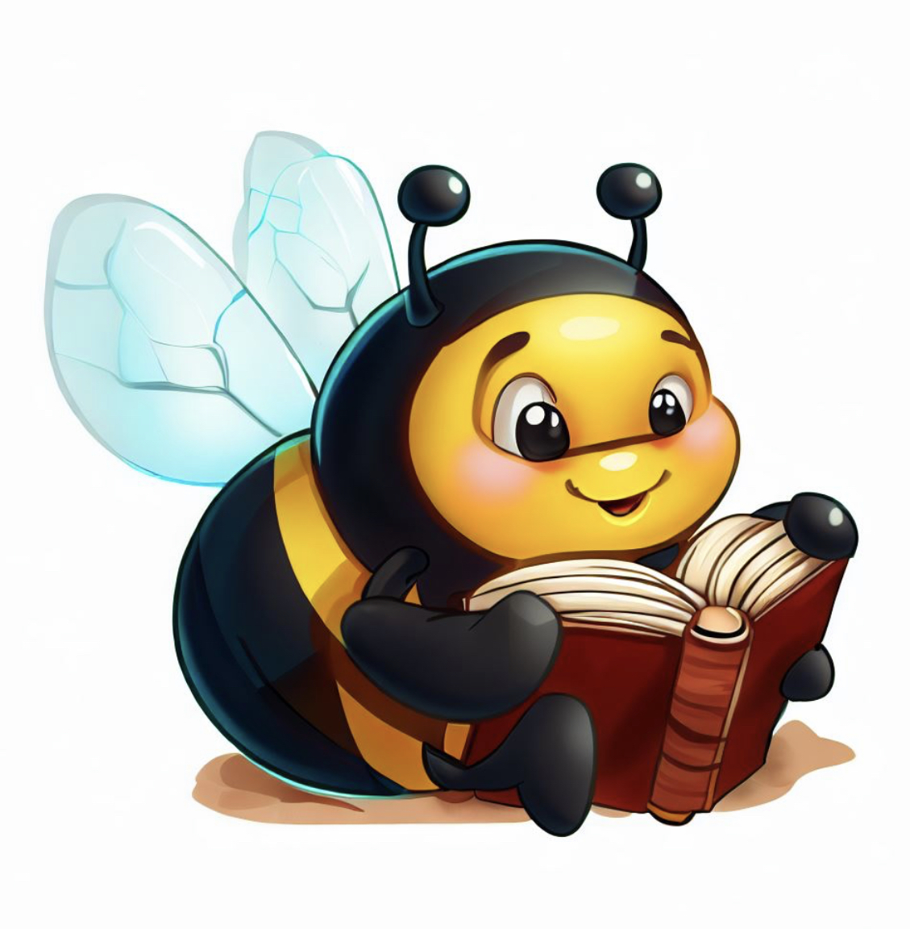
The bee is the student who is hardworking and cooperative. They like to work in groups and help others. They are often busy and productive, but they may also get overwhelmed by their workload.
They are good at organising and communicating, liking lots of feedback.

Slide 5
The owl is the student who is wise and curious. They like to learn new things and explore different perspectives. They are often night owls who study late and sleep during the day. They are good at analysing and synthesising information, they may be perfectionists who spend lots of time on details.

Slide 6
The dolphin is the student who is fun-loving and creative. They like to have fun and enjoy learning. They are often cheerful and optimistic, they may be distracted by shiny things and impulsive. They are good at innovating and improvising.

Slide 7
The animal descriptions and the associated images used in this activity were all created with the assistance of Bing and Chat GPT-4
Chat GPT (2023) Bing, response to Rob Moore 18th September

